Slide 1

PROCESS
GRAPHIC

Slide 2
To use this template click File > Make a copy

Slide 3
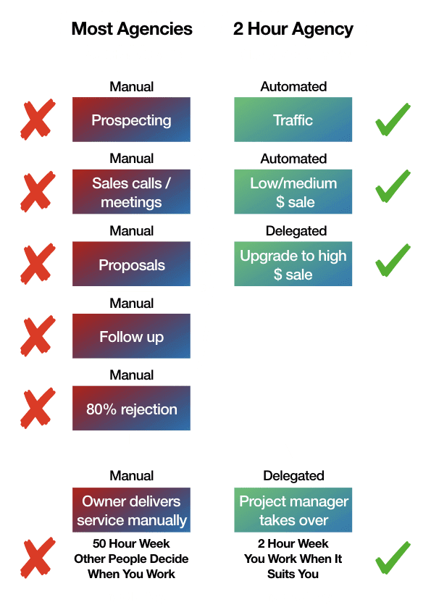
EXAMPLE

Slide 4
ASSETS
The Old Way
The New Way
The Hard Work Way
The Easy Way
Difficult Step 1
Easy Step 1
Difficult Step 2
Difficult Step 3
Easy Step 2
Difficult Step 4
Difficult Step 5
Easy Step 3
Difficult Step 6
End Result Nobody Wants
Desired Result

Slide 5
ASSETS
The Old Way
The New Way
The Hard Work Way
The Easy Way
Difficult Step 1
Easy Step 1
Difficult Step 2
Difficult Step 3
Easy Step 2
Difficult Step 4
Difficult Step 5
Easy Step 3
Difficult Step 6
End Result Nobody Wants
Desired Result

Slide 6
ASSETS
The New Way
The Easy Way
Easy Step 1
Easy Step 2
Easy Step 3
Desired Result

Slide 7
CREATE YOURS ON THE NEXT SLIDE

Slide 9
To export your image (on the previous slide) click on the slide, then File > Download > PNG image (current slide)

